Slide 1


ISM3NY
Intelligent Sign language Manipulation using AI

Slide 2

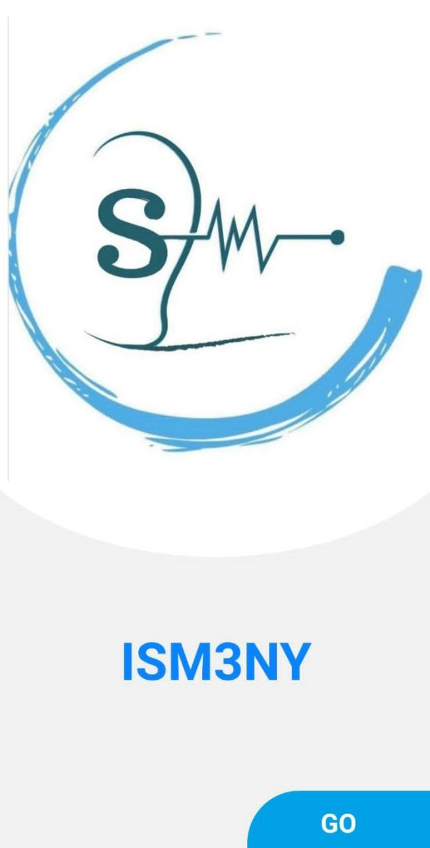
Overview
The Android app is designed to bridge the communication gap between sign language users and non-sign language users. It uses advanced technology to convert sign language gestures into spoken language in real time.
The app utilizes the smartphone's camera to capture hand movements and gestures.

Slide 3

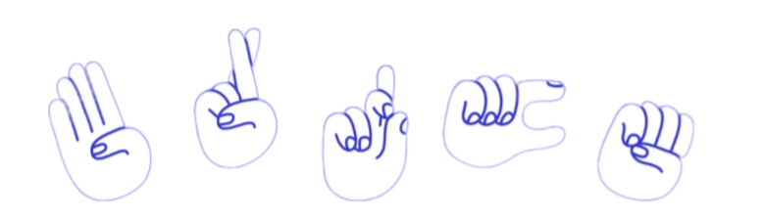
Key Features
Real Time Translation
The application provides instantaneous conversion of sign language to voice,
ensuring smooth and uninterrupted communication.
User Friendly Interface
A simple and intuitive user interface allows users to easily interact with the application.
Cross Platform Compatibility
The application is designed to work on multiple platforms including smartphones, tablets

Slide 4








Technologies
Languages
AI & Machine Learning
Frontend & backend

Slide 5

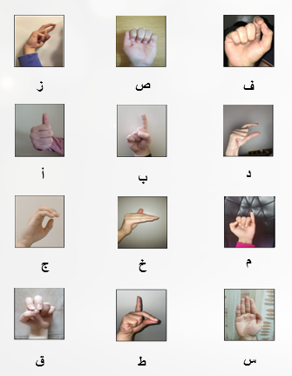
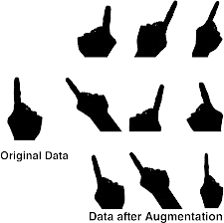
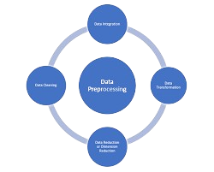
.
About the Dataset
Dataset Composition
Data Augmentation
Data Preparation

Slide 6

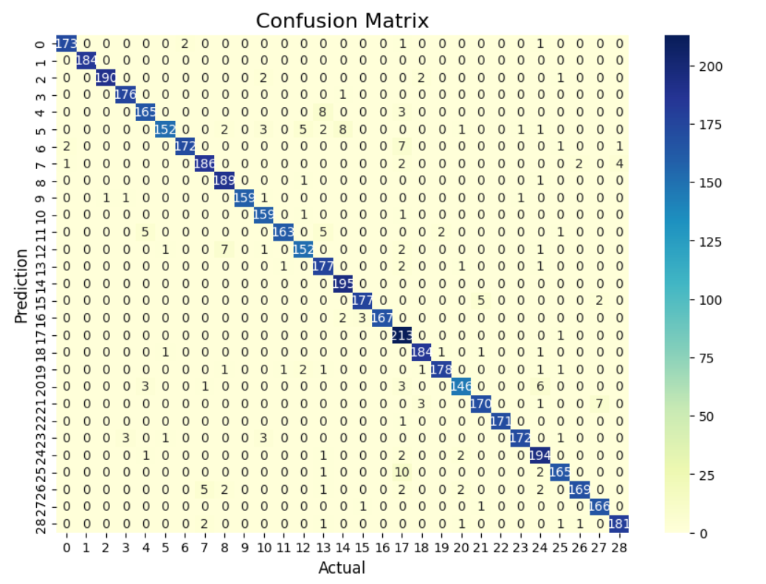
Model Optimization and Deployment
EfficientNetB0 was chosen for its balanced performance and computational.
Model Evaluation
on a test set using accuracy and confusion matrix metrics.
Model Conversion
TensorFlow Lite used for efficient deployment on mobile and embedded devices.

Slide 7
Application Map
Log in
Start
Definition Page
Sign up
Choose
Combine Letters
Only detection
Show Result
Show Result
Display Voice

Slide 8
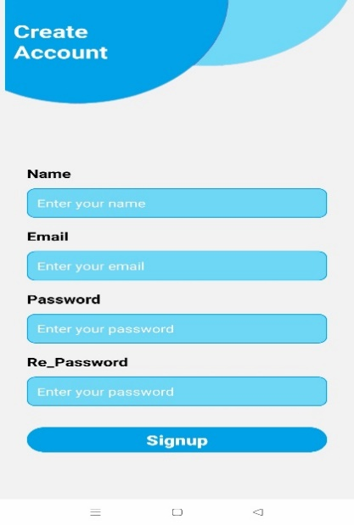
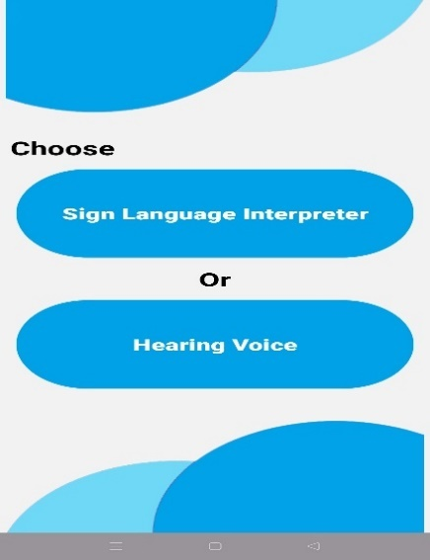
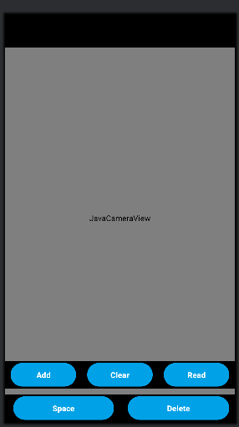
App Interfaces
Dual Modes
User Authentication
Real-Time Recognition

Slide 9
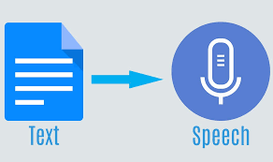
application Functionality
In our application we have the the most 2 important functionality are:
Text To Speech
Combine word
م ر ح ب ا
مرحبا
Convert text of sign language to voice by using API
Combine letter to form a word to Combine words to form a sentence and convert it to voice

Slide 10
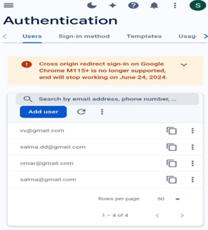
Backend Services
Database: Stores user preferences, custom vocabulary, and usage history.
Services like Firebase or AWS can be used for database management
API : For your Android app that converts sign language to voice,
using remote APIs allows you to integrate advanced features like text-to-speech

Slide 11
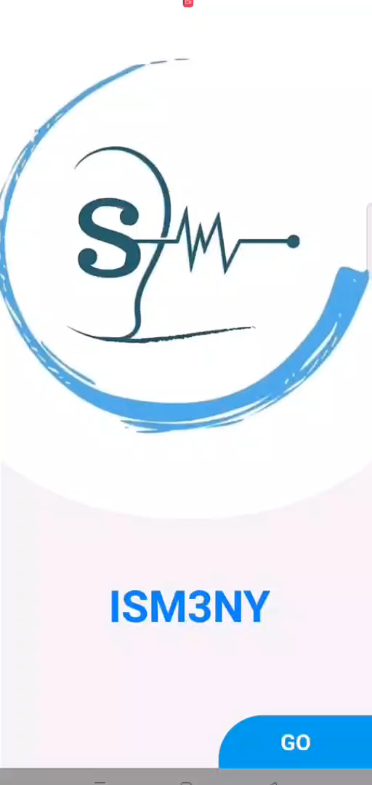
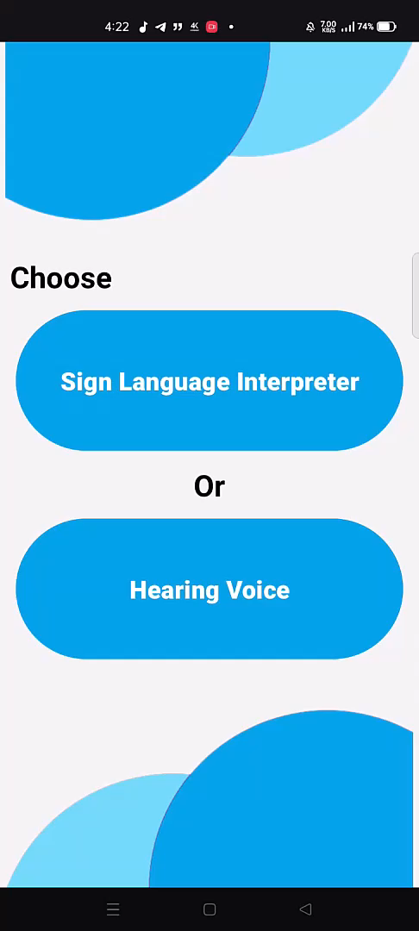
Project Demo

Slide 12
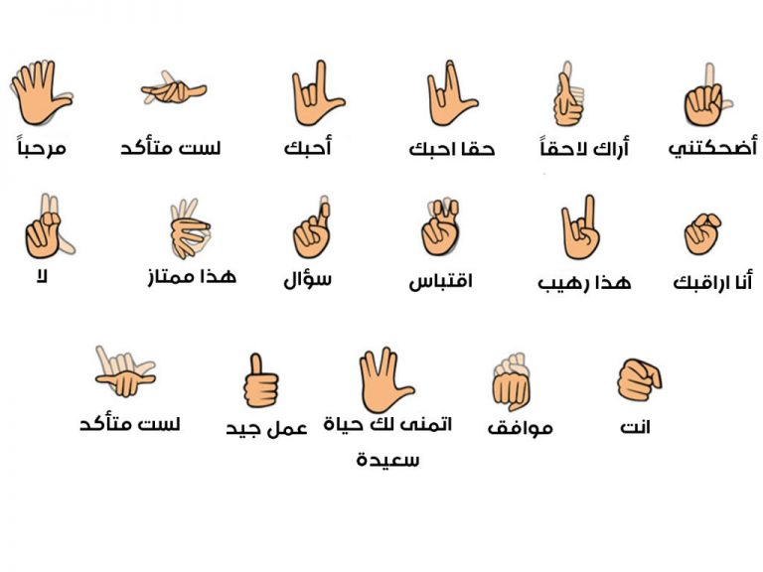

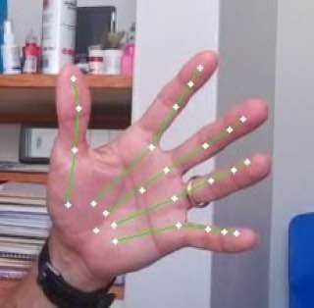
Our Future Enhancements
Full Sentence Recognition
Additional Language Support
Enhanced User Interface
continually improve the user interface and overall user experience.
Improvements in AI Accuracy

Slide 13
Our Team
Asmaa Moayad Attia Mohammed
Salma Wael Abdel mageed hasan
Salma Magdy Saeed Mohammed
Somia Mohamed Amrallah
Doaa Muhammed El-Qurany
Omnia Hasan Ahmed Bekerr
THANK YOU
Supervised by:
Dr. Momtaz Saad AlKholy

